Slide 1

Working with Images and Text
Reading, exploring and analyzing, feature extraction
Yordan Darakchiev
Technical Trainer
iordan93@gmail.com

Slide 2
sli.do #Data-Science

Slide 3
Table of Contents
Image processing
Reading, exploring, manipulation
Convolution
Image morphology
Text processing
Text preparation
Frequency analysis
TF-IDF

Slide 4
Image Processing
Understanding what people see

Slide 5
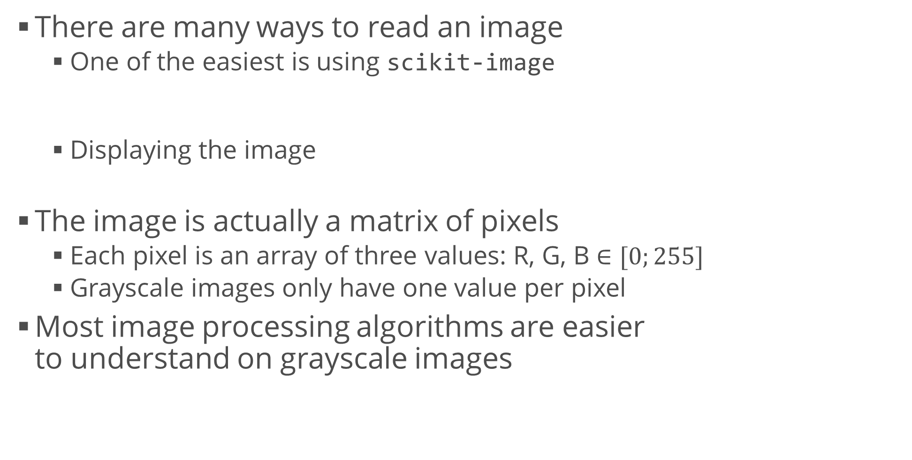
Loading and Inspecting Images
There are many ways to read an image
One of the easiest is using scikit-image
Displaying the image
The image is actually a matrix of pixels
Each pixel is an array of three values: R, G, B $∈[0;255]$
Grayscale images only have one value per pixel
Most image processing algorithms are easier to understand on grayscale images
from skimage.io import imread
tiger_image = imread("tiger.jpg")
plt.imshow(tiger_image)
red = tiger_image[:, :, 0]
green = tiger_image[:, :, 1]
blue = tiger_image[:, :, 2]

Slide 6
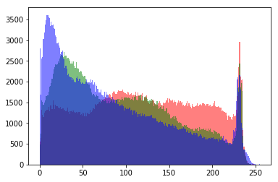
Image Histogram
As usual, histograms tell us how the values are distributed
How many dark values, how many light values
Maximum brightness, peaks, etc.
Histograms need to have a single variable
Take each channel separately, e.g. red
Convert the 2D matrix to 1D array: image.ravel()
Show the histogram as usual
It’s common to use 256 bins
We can also plot all channels on a single histogram
plt.hist(red.ravel(), bins = 256, color = "red")
plt.show()

Slide 7
Converting to Grayscale
Sometimes working per channel is not necessary
We can combine all three channels and get a grayscale image
Simplest way: get the mean of all values
Better way: use coefficients for each channel
The human eye discerns colors differently
We’re more sensitive to green colors
Some formulas are given here
Depending on the image, the differences may or may not be easy to see
It’s easiest to see the differences when we compare the histograms
For art purposes, we can experiment with our own coefficients for combining all channels
tiger_grayscale = np.mean(tiger_image, axis = 2)
tiger_grayscale = 0.299 * red + 0.587 * green + 0.114 * blue

Slide 8
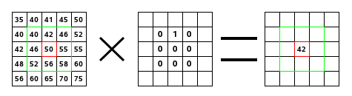
Convolution
Convolution kernel (filter)
A small, usually 3x3, matrix of numbers
Convolution process
Input: image, kernel; output: new image
Combining the image and a kernel
Apply the kernel over each pixel
Multiply the values element-wise (Hadamard product)
Sum all values
Assign the sum to the corresponding pixel in the output image
Image corners are treated in different ways, not really important how

Slide 9
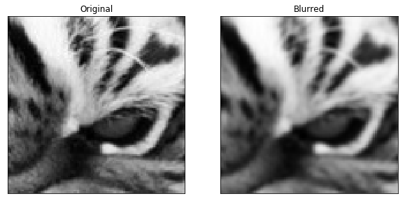
Convolution (2)
The choice of kernel depends what the output image will represent
Some ideas here
Example: box blur
from scipy.ndimage.filters import convolve
convolve(image, kernel)
box_blur_kernel = np.array([
[1, 1, 1],
[1, 1, 1],
[1, 1, 1]
]) / 9
blurred = convolve(tiger_grayscale, box_blur_kernel)
plt.imshow(tiger_grayscale[150:250, 300:400], cmap = "gray")
plt.show()
plt.imshow(blurred[150:250, 300:400], cmap = "gray")
plt.show()

Slide 10
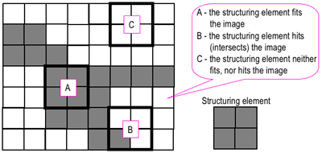
Image Morphology
Four main operations (see this tutorial)
Dilation, erosion, opening, closing
A simple series of algorithms for image transformation
Basic methodology
Choose a structuring element (e.g. 2x2 square or cross)
Move the element around the image
Apply an operation
Input: binary image
Pixel values 0 and 1, not [0; 255]
This is called thresholding
Output: transformed image

Slide 11
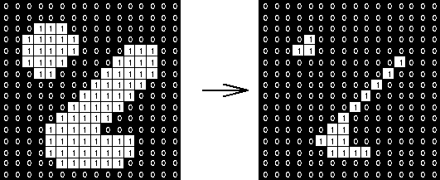
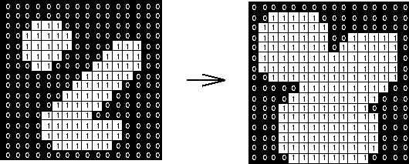
Image Morphology (2)
First get all values inside the structuring element
Erosion: replace all values with the min value
Strips away a layer of pixels
Holes become larger
Small regions are eliminated
Dilation: replace all values with the max value
Adds a layer of pixels
Gaps become smaller
Small gaps are filled in

Slide 12
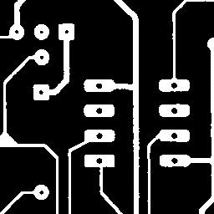
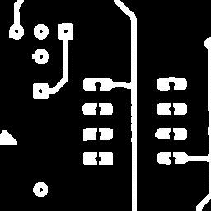
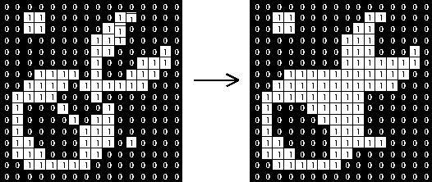
Image Morphology (3)
Opening: erosion followed by dilation
Pixels which survived erosion are restored to their original size
Opens up a gap between two objects connected by thin bridges
Closing: dilation followed by erosion
Fills in holes in the regions while keeping the initial region sizes

Slide 13
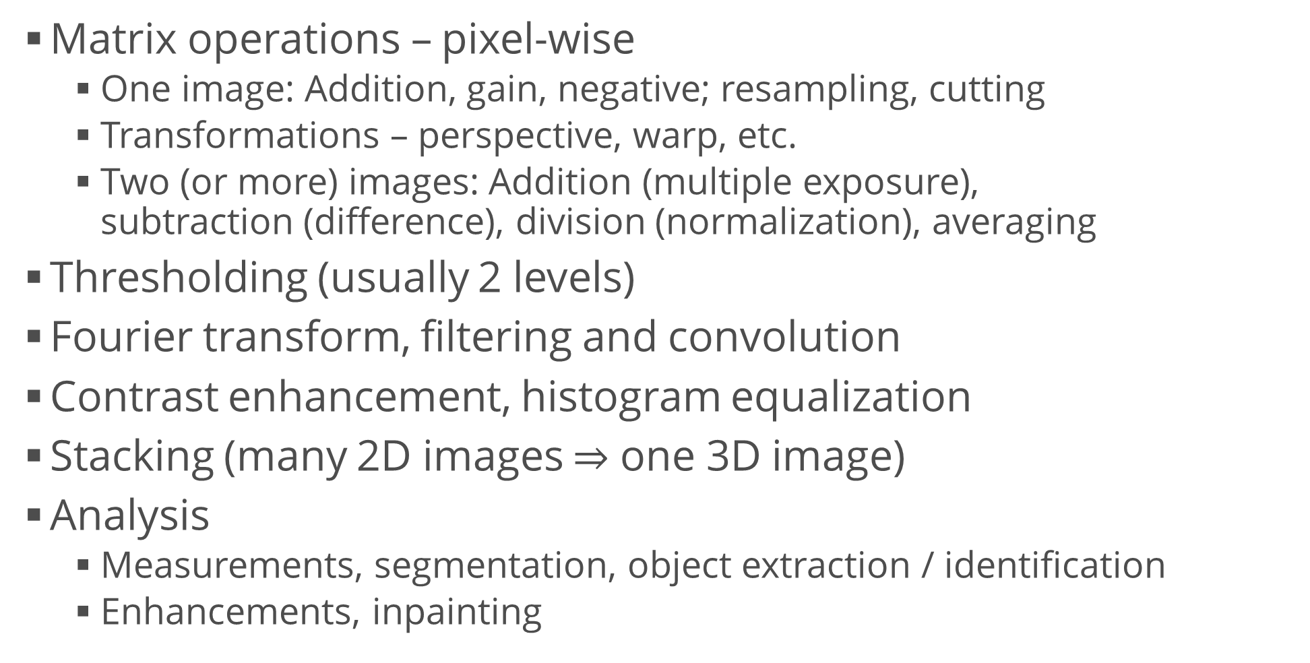
Other Operations on Images
Matrix operations – pixel-wise
One image: Addition, gain, negative; resampling, cutting
Transformations – perspective, warp, etc.
Two (or more) images: Addition (multiple exposure), subtraction (difference), division (normalization), averaging
Thresholding (usually 2 levels)
Fourier transform, filtering and convolution
Contrast enhancement, histogram equalization
Stacking (many 2D images $⇒$ one 3D image)
Analysis
Measurements, segmentation, object extraction / identification
Enhancements, inpainting

Slide 14
Text Processing
Understanding what people write

Slide 15
Text Data
Documents, written in plain text
News, tweets, blog posts, poems, books, legal documents, etc.
May also be auto-generated (i.e. server logs)
Objective
Preprocess the text data so that it's structured
Algorithms can analyze a table of numbers, not plain text
This is especially true for machine learning algorithms
Applications
Sentiment analysis
Grouping texts – similar topics, similar authors
Classification (e.g. spam / fake news prevention)
Text summarization, etc.

Slide 16
Character Frequencies
Reading is simple: open the file, read it, close it
A string is a collection of characters
There are several ways to count them, the easiest being by using a library: collections.Counter
Most common characters ("etaoin shrdlu")
Similarly, most common words: split by all non-word characters
text = ""
with open("alice.txt", "r", encoding = "utf-8") as f:
text = f.read()
print(len(text))
from collections import Counter
char_counter = Counter(text)
char_counter.most_common(20)
import re
word_counter = Counter(re.split("\W+", text))

Slide 17
Preparing Text Data
Before we start working with the text, we have to "normalize" and clean up the messy data
Remove all non-letter characters
Numbers, punctuation, whitespace, etc.
If needed, apply additional rules, e.g. if we're looking at tweets, @mention means a username and we may want to get rid of it
Transform all characters to lowercase
Remove "stopwords"
Words that are too frequent in all documents and don't contain much information such as "the", "a", "is", etc.
Perform stemming
Extract the stems of all words, e.g. "connected", "connection", "connecting" should all point to "connect"

Slide 18
Stopwords and Stemming: NLTK
NLTK is a library for working with natural language
Contains all frequently used algorithms and corpora
Installation: as usual, using conda:
Getting and removing stopwords
Download the words first
Stemming – Porter's algorithm (includes many "manual" rules)
conda install nltk
import nltk
nltk.download("stopwords")
from nltk.corpus import stopwords
stop = set(stopwords.words("english"))
sentence = "this is a foo bar sentence"
print([w for w in sentence.lower().split() if w not in stop])
from nltk.stem.porter import *
stemmer = PorterStemmer()
words = ["caresses", "flies", "dies", "seizing", "itemization", "sensational", "traditional", "reference", "plotted"]
print([stemmer.stem(word) for word in words])

Slide 19
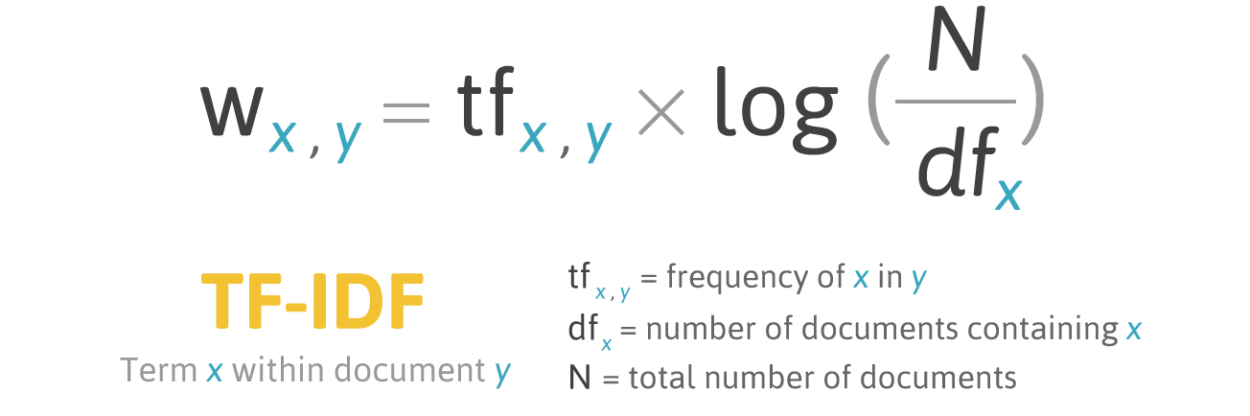
TF – IDF
Term frequency – inverse document frequency
A common method to preprocess the text
High score: rare, specific words
Hypothesis: these may be better related to the topic
Note: This may also include misspelled words and / or names
Low score: words that occur in nearly all documents

Slide 20
Using TF – IDF
Read the "20 newsgroups" dataset (from scikit-learn)
Initialize the algorithm (docs) and compute the matrix
Get all feature names
Get the IDF for each word / n-gram in one document
from sklearn.datasets import fetch_20newsgroups
# Download only some categories to speed up the process
newsgroups = fetch_20newsgroups()
tfidf = TfidfVectorizer(input = "content", analyzer = "word",
ngram_range = (1, 4), min_df = 0, stop_words = stop, sublinear_tf = True)
tfidf_matrix = tfidf.fit_transform(newsgroups.data)
feature_names = tfidf.get_feature_names()
doc = 0 # Change the index to view another document
feature_index = tfidf_matrix[doc, :].nonzero()[1]
tfidf_scores = zip(feature_index, [tfidf_matrix[doc, x] for x in feature_index])
for w, s in [(feature_names[i], s) for (i, s) in tfidf_scores]:
print(w, s)

Slide 21
Summary
Image processing
Reading, exploring, manipulation
Convolution
Image morphology
Text processing
Text preparation
Frequency analysis
TF-IDF

